Slide 1


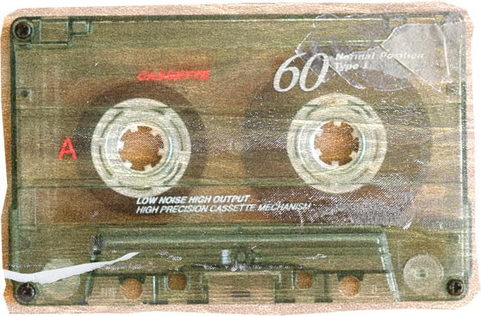


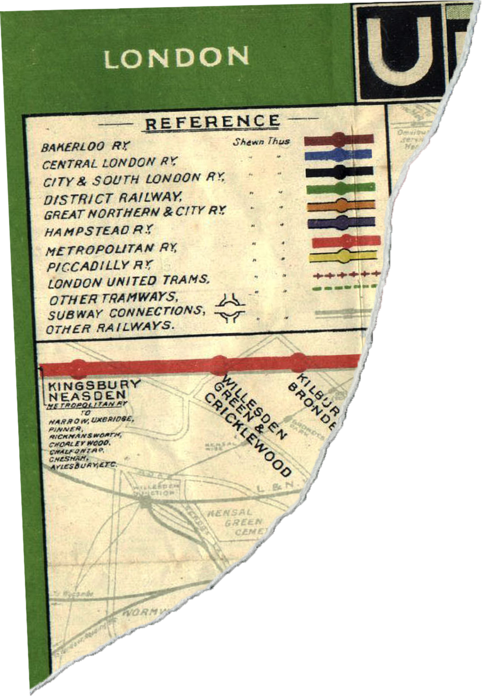


SQL MURDER MYSTERY
PRESENTED BY: JYOTI PARMAR

Slide 2


BREAKING NEWS
The CEO of TechNova Inc. has been found dead in their office on October 15, 2025, at 9:00 PM.

Slide 3

“Who Killed the CEO?”
A complete investigation using sql to identify killer

Slide 4
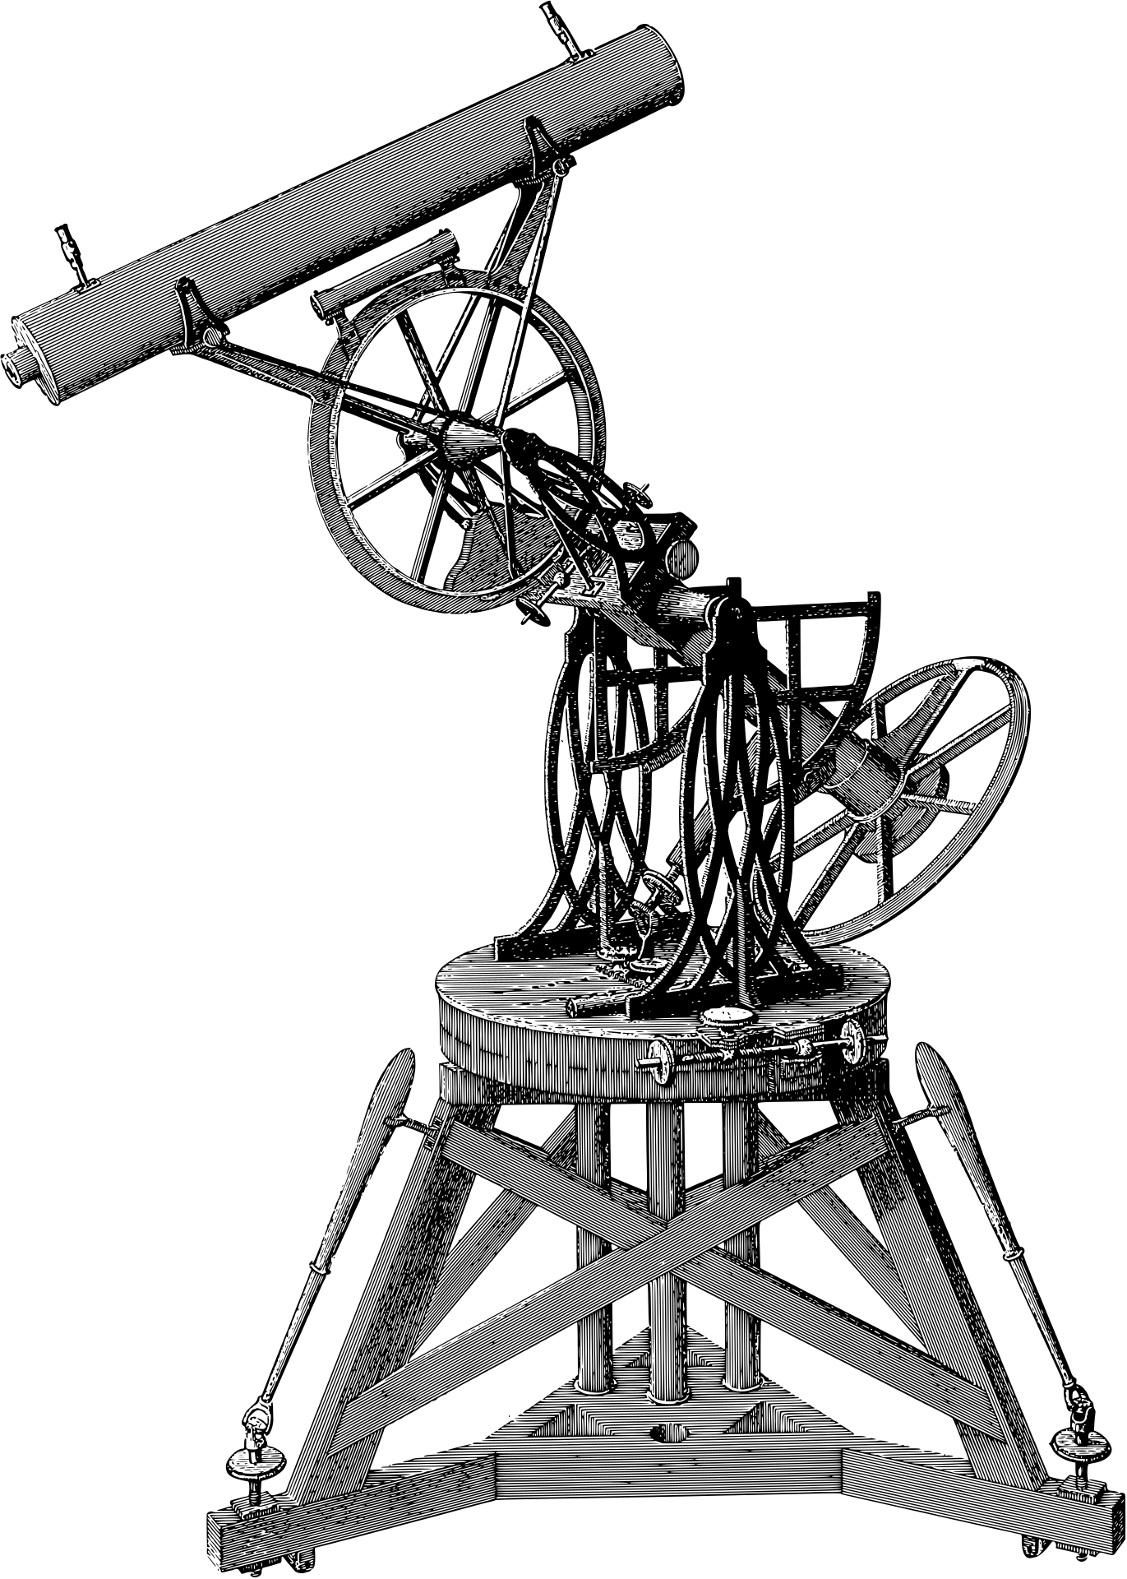
Case Overveiw
CRIME SUMMARY
Date: 15 Oct 2025
Time: 9:00 PM
Crime Location: CEO Office
GOAL TO UNCOVER:
Who was present
Who lied
Who was suspect
Who killed the CEO

Slide 5

Database Analysis
KEYCARD LOGS
EMPLOYEES: EMPLOYEE DETAILS
CALLS: PHONE CALL RECORDS
ALIBIS: CLAIMED
EVIDENCE: PROOF FOUND IN DIFFERENT ROOMS
All the clues are hidden in the company’s databases.

Slide 6
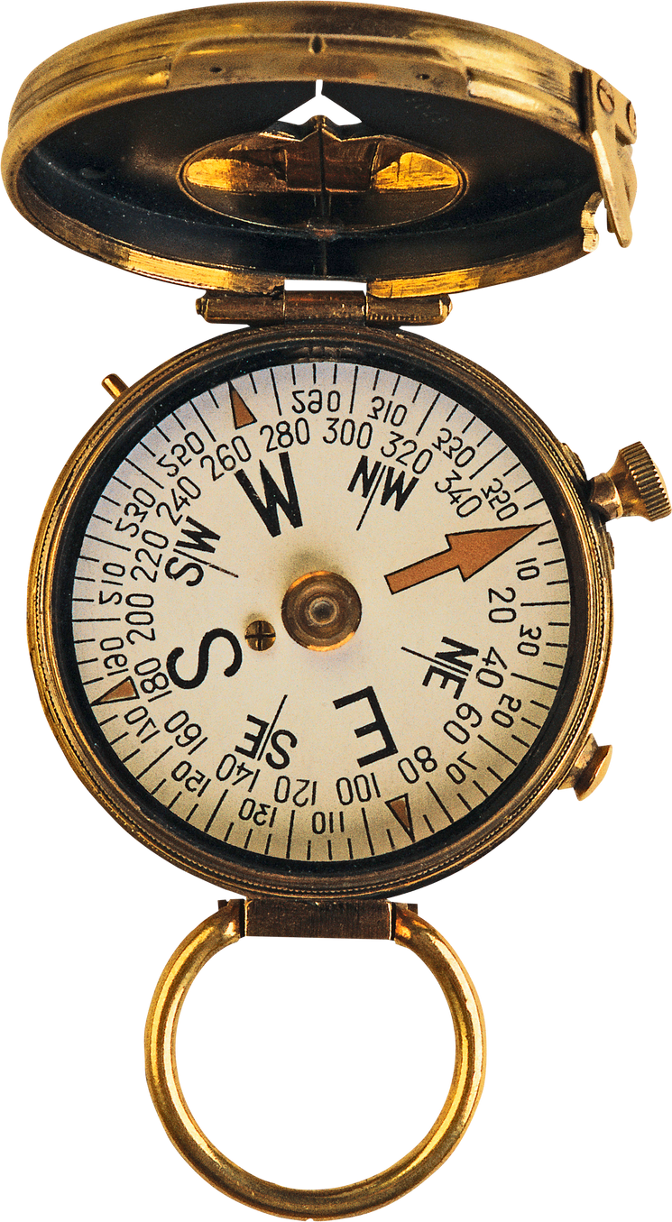
Investigation Steps
SQL MYSTERY STEPS
1. Identify where and when the crime happened
2. Analyze who accessed critical areas at the time
3. Cross-check alibis with actual logs
4. Investigate suspicious calls made around the time
5. Match evidence with movements and claims
6. Combine all findings to identify the killer

Slide 7

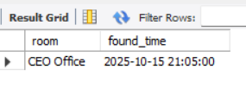
SQL Query:
WHERE AND WHEN THE CRIME HAPPENED
select room, found_time
from evidence
where found_time
between '2025-10-15 20:50:00' and '2025-10-15 21:05:00';
Insight: Crime tookplace in ceo’s office at 21:05

Slide 8

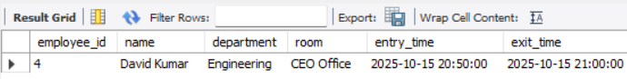
WHO ACCESSED CRITICAL AREAS AT THE TIME
select e.employee_id, name, department, room, entry_time, exit_time
from employees e
join keycard_logs k on k.employee_id = e.employee_id
where '2025-10-15 21:00:00' between entry_time and exit_time;
Insight: David kumar was in ceo’s office at crucial time

Slide 9
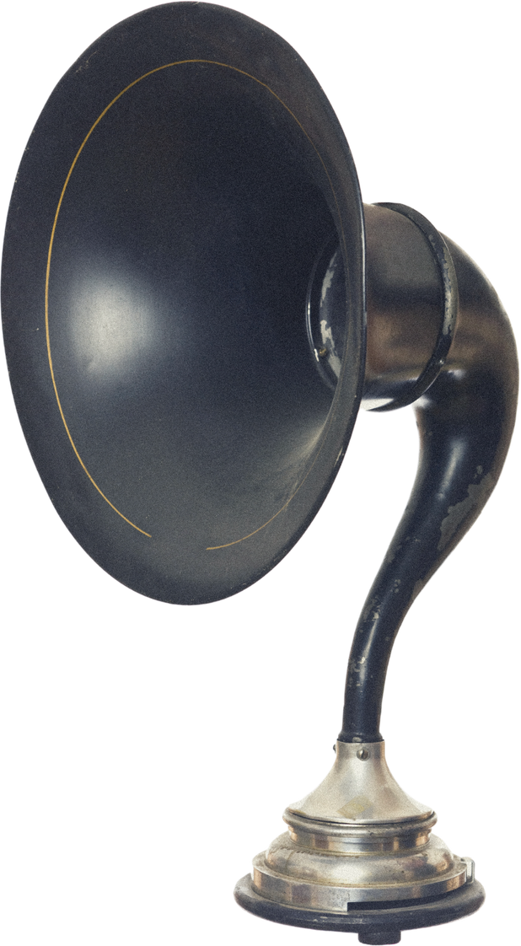
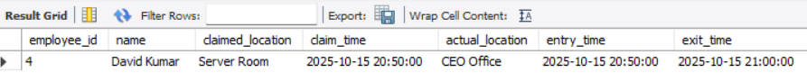
CROSS-CHECK ALIBIS WITH ACTUAL LOGS
select k.employee_id,
e.name, claimed_location, claim_time, room as actual_location, entry_time, exit_time
from alibis a
join employees e on e.employee_id = a.employee_id
join keycard_logs k on a.employee_id = k.employee_id
and claim_time between entry_time and exit_time;
Insight: Again David kumar line up with keycard data.

Slide 10
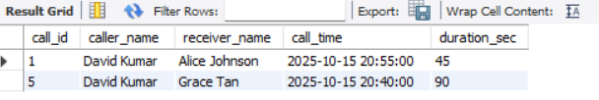
INVESTIGATE SUSPICIOUS CALLS MADE AROUND THE TIME
select call_id, e.name as caller_name, e1.name as receiver_name, call_time, duration_sec
from calls c
join employees e on e.employee_id = c.caller_id
join employees e1 on e1.employee_id = c.receiver_id
where
call_time between '2025-10-15 20:00:00' and '2025-10-15 21:00:00';
Insight: David kumar made calls at crucial time

Slide 11
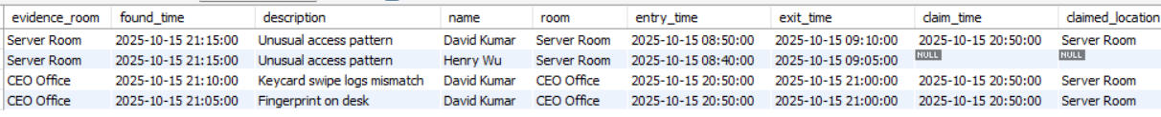
MATCH EVIDENCE WITH MOVEMENTS AND CLAIMS
select ev.room as evidence_room, ev.found_time, ev.description,
e.name, k.room, k.entry_time, k.exit_time,
a.claim_time, a.claimed_location
from evidence ev
join keycard_logs k on k.room = ev.room
join employees e on k.employee_id = e.employee_id
left join alibis a on e.employee_id = a.employee_id;
Insight: Evidense received from CEO’s office and the claims pointed towards ‘David Kumar’

Slide 12

COMBINE ALL FINDINGS TO IDENTIFY THE KILLER
step 1: investigation
with investigation as(
select e.employee_id, name, room, entry_time, exit_time
from employees e
join keycard_logs k on k.employee_id = e.employee_id
where '2025-10-15 21:00:00' between entry_time and exit_time
),
step 2: crime_place
crime_place as(
select room, found_time, description
from evidence
where found_time between '2025-10-15 21:00:00' and '2025-10-15 21:05:00' ),
),

Slide 13
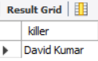
COMBINE ALL FINDINGS TO IDENTIFY THE KILLER
step 3: suspect
suspect as (select employee_id,
name as killer, i.room, entry_time, exit_time
from investigation i
join crime_place c on i.room = c.room )
select killer from suspect;
KILLER : DAVID KUMAR

Slide 14
THANK YOU

